Slide 1
Python: getting started
Working environment, programming basics, write and run a program

Slide 2
Why python?
Python is an extremely useful programming language for getting science done. It is fast enough and simple enough for most tasks – although compiled languages like C++, Fortran90, and Java are faster.
Python is often called a "glue language" because it is adept at working in and across many computing platforms, and integrating programs running in other languages.
Like MATLAB, it has tight integration of programs, command line interactivity, and publication-quality graphics.
Unlike MATLAB, it is open source, so there are toolboxes (called "modules" in python) created by many different groups for different tasks. This can be good because you can find a module to do almost anything, and it can be bad because quality control and conventions are not as strict as they are at MathWorks (the company that makes MATLAB).
Python is free and you can install it easily on any machine.

Slide 3
Your work environment
I try to keep my python environment as simple as possible:
Launch ipython in a linux terminal window by typing:
ipython --pylab
Keep a text editor next to it for editing whatever program(s) you are running
Plots come up in their own window.
NOTE: if you are working on a remote machine you won’t have graphics windows that pop up, so just launch ipython by typing ipython (no -- pylab).

Slide 4
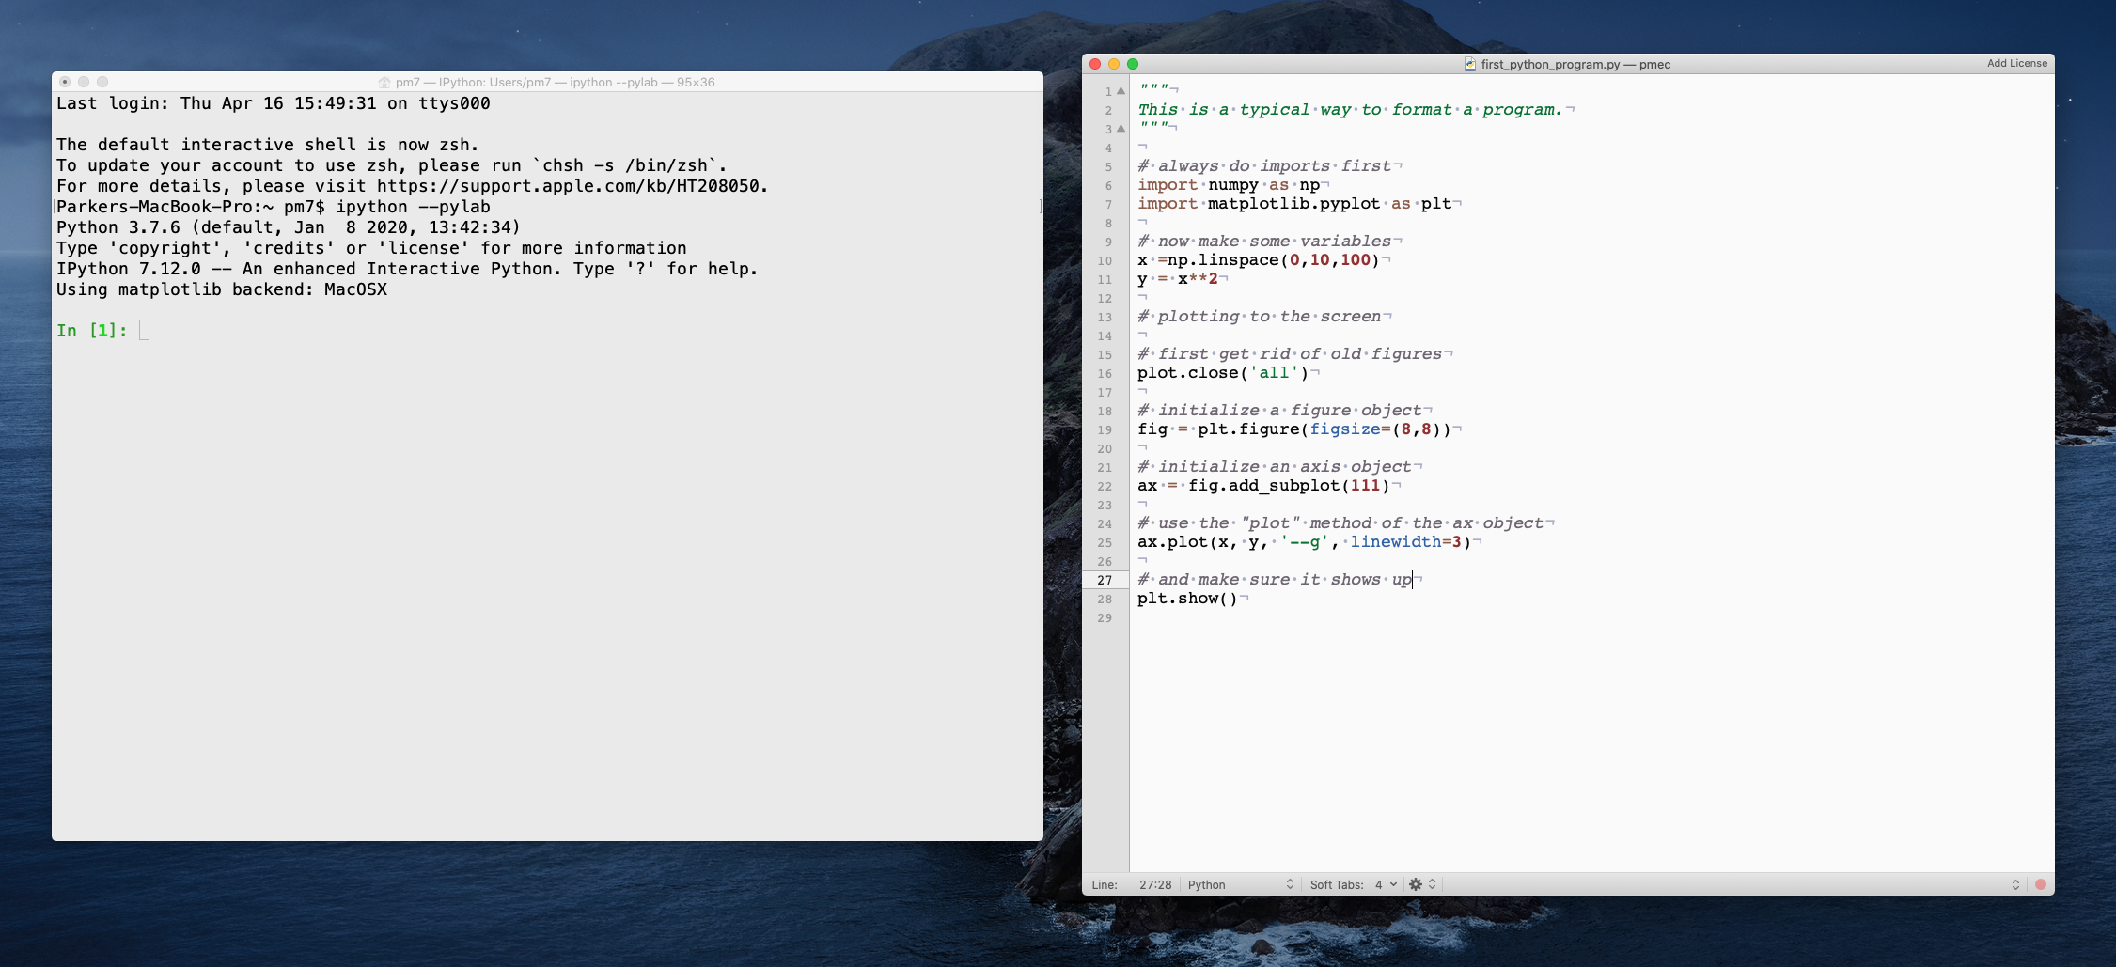
My python working environment
The mac terminal window
The text editor (I use TextMate)

Slide 5
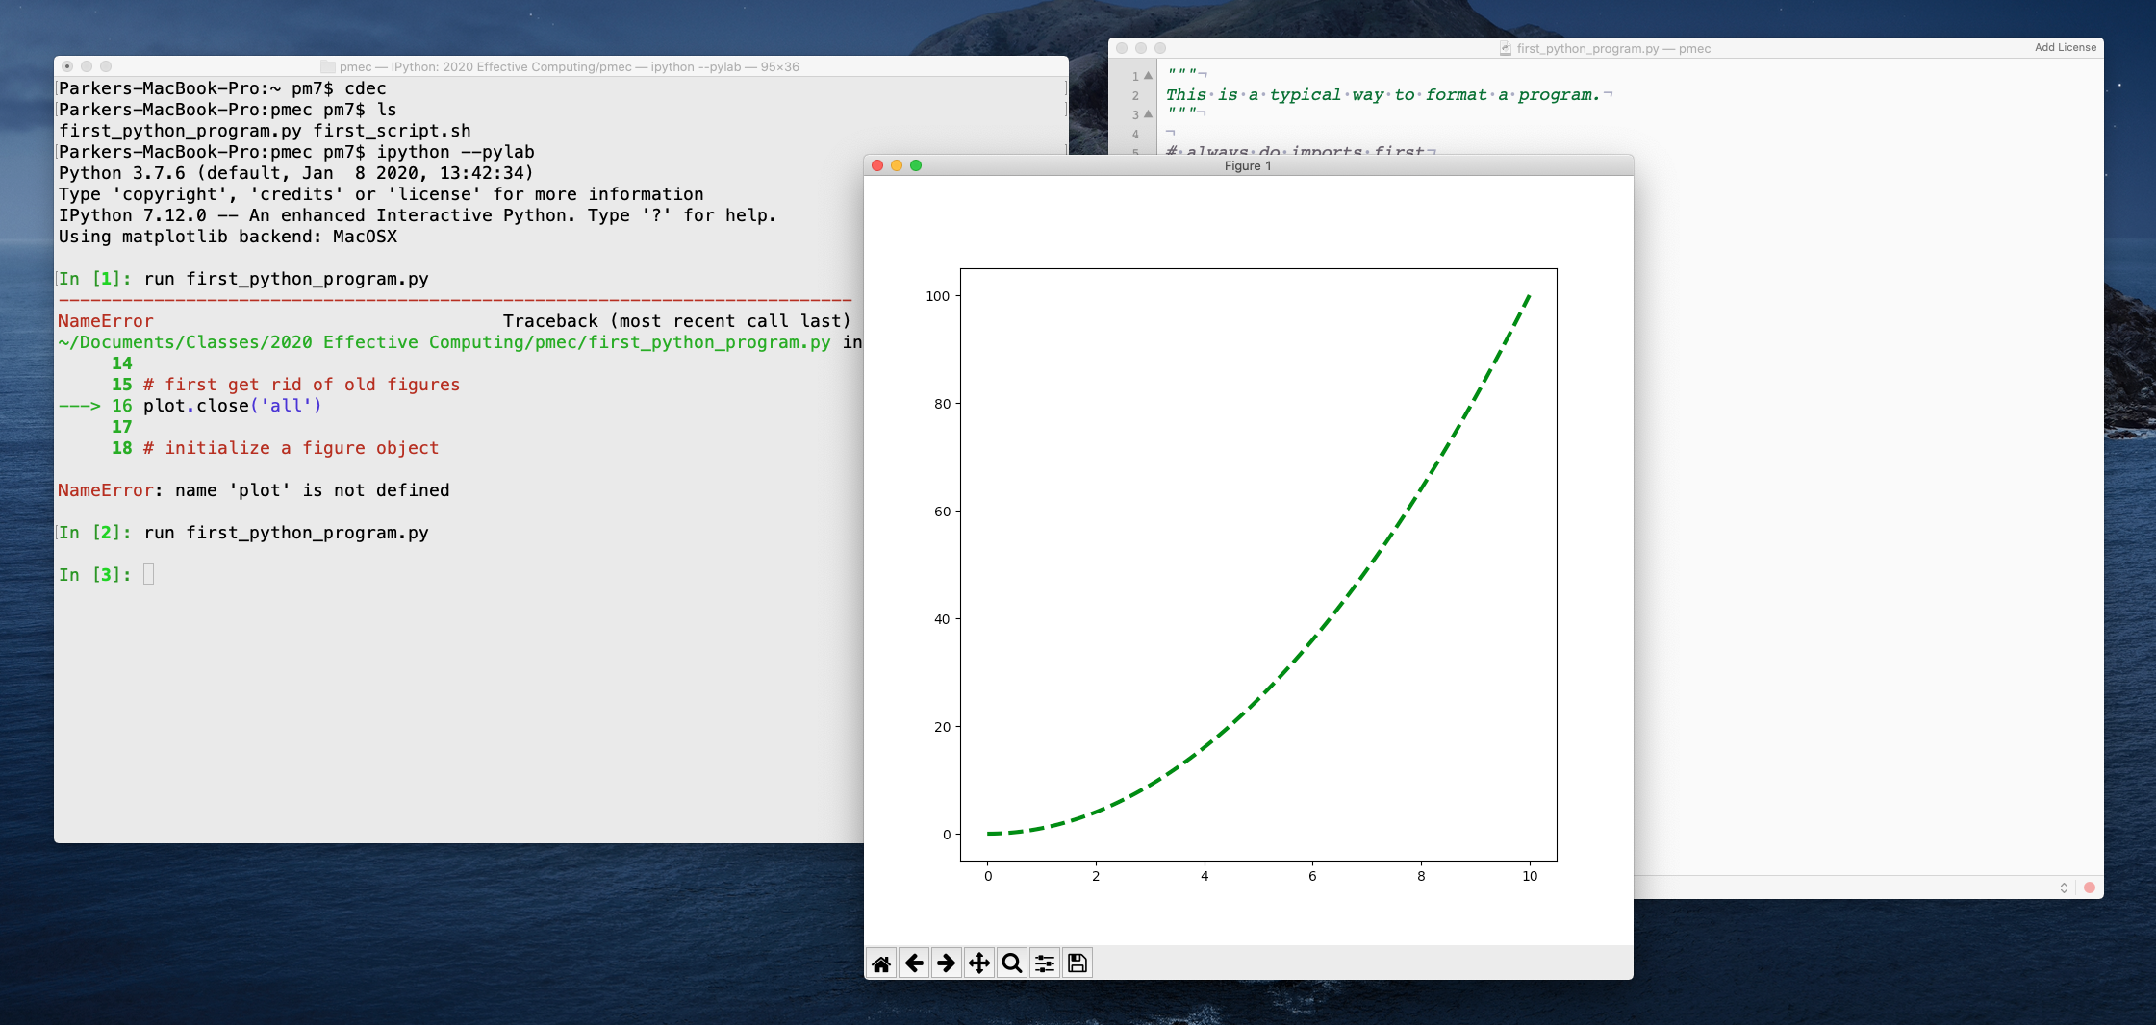
A plot window comes up when I run the code
Try out the little icons. They allow you to zoom in or save the plot to a file,

Slide 6
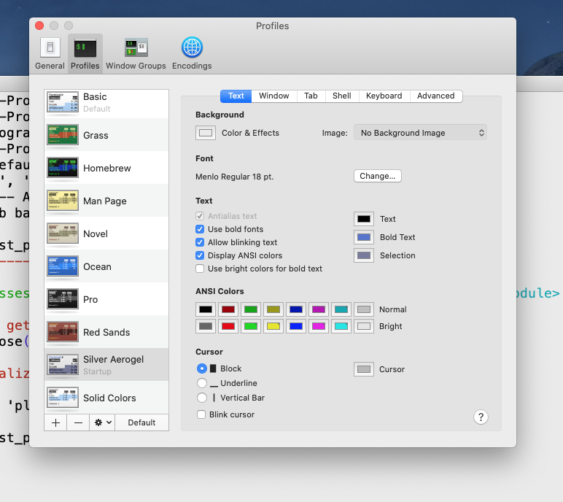
You can make adjustments to how your terminal window looks (Terminal => Preferences)

Slide 7
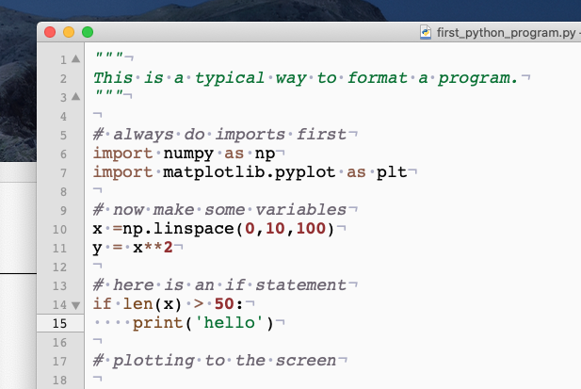
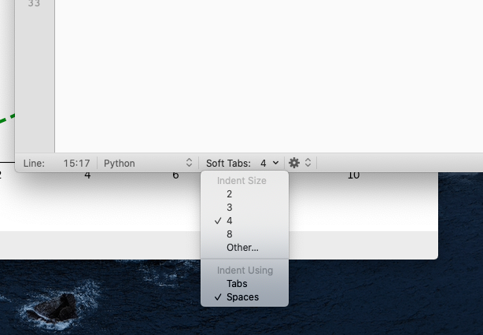
Spaces matter in python so you want to have them show up in your text editor
Set your editor so that entering a "tab"
adds 4 spaces

Slide 8
ipython
You can launch python in several ways from the linux command line.
To just run a program from the bash shell (or cron) type:
python [program name].py
or if it is a long job on a remote machine and you want to logout:
python [program name].py > log.txt &
Alternatively you can enter the ipython environment by typing:
ipython --pylab
and then...
run [program name].py
To escape from ipython back to the bash shell type:
quit

Slide 9
ipython, continued...
ipython is the "interactive python" environment, and it is what you should always use. The "--pylab" option silently adds the numpy and matplotlib modules to your interactive workspace and sets the graphical backend.
The ipython environment allows you to quickly see information about the variables you are using in your program, and it has some nice help features, and tab-completion when you type.

Slide 10
Useful commands in ipython for getting information (try them!)
"whos" gives information about all the variables in your workspace
Python is an "object-oriented" language, which is just a fancy way of saying that everything, whether it be a variable, a function, a line on a plot, or a module, is an "object" that has associated attributes (facts about it) and methods (functions that can act on it).
"[object]?" gives info about a variable or other object
"help([object])" is another way of getting info about an object
"dir([object])" gives a full listing of the attributes and methods available for a given object

Slide 11
Resources
Learning python programming is a long process - I learn new things all the time. This class will get you started, but you need to learn most of it on your own.
Read a book. My favorite is: McKinney (2018) Python for Data Analysis, 2nd Edition. O'Reilly.
Find a website with instructions. Here is a reasonable one: https://docs.python.org/3/tutorial/
Ask someone, even me.
Make a list of commands you want to memorize and keep editing it as you go along.

Slide 12
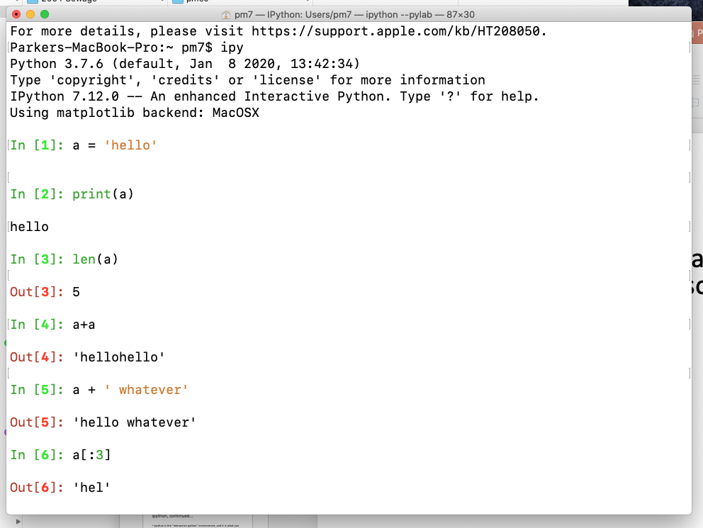
Now, on to python language basics, starting with some types of variables...
Strings
Strings are just lists of characters. You often use them to define input and output pathnames, so it is good to learn how to manipulate them. You make them using quote marks: 'string'. (Single or double quotes both work.)
Try typing the commands at the right yourself.
Then try out the commands from the previous pages to get information on what you can do to strings (like whos and dir and ?)
E.g., what does "a.title()" do? How about "a.find('h')"?
"title" is an example of a "method" that string objects have. Methods always have () after them.
To use a method just type:
[object].[method]() # note the dot!

Slide 13
Indexing, with a = 'hello'
a[:3] => 'hel' is an example of indexing, or "slicing". The same indexing rules apply to strings, lists, numpy arrays and pandas DataFrames, so you need to know how it works.
The first item is at index 0, so the index numbers of 'hello' would be 0,1,2,3,4
Specify a range with a ":" and some integer indices for the range:
[start index]:[index after the last one you want to get]
a[1:4] => 'ell' (when I type "=>" that means "returns", it is not part of the command!)
Note that you can always tell the length of what you get by the difference of the two indices (4 - 1 = 3)
Omitting the start index means starting at 0.
Omitting the end index means get through the last item, a[2:] => 'llo'
You can also add a step with another colon (start:stop:step)
a[::2] => 'hlo'
Use a step of -1 to reverse the order
a[::-1] => 'olleh'
Using an ending index of -2 cuts off the last two letters:
a[:-2] => 'hel'

Slide 14
Lists
Lists are just ordered collections of objects. You form them by using square brackets and commas:
my_list = ['hi', 99, 'hello']
the same indexing rules apply:
my_list[1] => 99
You concatenate lists using the plus sign
my_list + ['NNN'] => ['hi', 99, 'hello', 'NNN']
Note that the thing I added, ['NNN'], had to also be a list, so it needed square brackets of its own.
"Tuples" are another kind of list that you form using parentheses and commas. They act just like lists but are meant for information that you don't want to be able to change.
my_tup = ('hi', 88, 6)

Slide 15
Dictionaries ("dict")
A dictionary is a way of associating two lists of information. You make them using curly brackets, colons, and commas:
my_dict = {'a':'Thing One', 'b': 'Thing Two', 'c':'Thing Three'}
these are called "keys" and "values"
Try typing my_dict.keys() or my_dict.values()
Accessing one value using its key: my_dict['b'] => 'Thing Two'
or more generally:
my_dict[key] => value associated with key
You can make a dict quickly out of two equal-length lists:
my_dict = dict(zip(list1, list2))
the function dict() is another way of creating a dictionary.

Slide 16
Iteration
You can "iterate" over any list using a colon and then a tab (4 spaces!) in front of the subsequent lines.
for item in my_list:
print(item)
The "range" function is a quick way to make a range of integers.
for item in range(10):
print(item)
You can iterate over the keys in a dict using "for item in my_dict.keys():".
Python lingo: anything you can iterate over is called "iterable". You can even iterate over the characters in a string, or the numbers in a numpy vector, or the indices in a pandas DataFrame.
The word "item" in the examples above is not special, but the words "for" and "in" are part of the programming language (try using "in" as a variable name and see what happens).

Slide 17
if-elif-else and "Booleans" (True, False)
Another variable type in python is a Boolean, which is either "True" or "False" (you have to type them capitalized).
The usual comparison operations will return Booleans:
for x in range(5):
if x == 0:
print(x)
elif x >=3:
print('Big x = ' + str(x))
else:
print('I do not care')
Each if, elif, else must be followed by one or more code lines. You can use the command "pass" as a way of doing nothing.
Note that the indenting is essential. Python does not end things explicitly with and "end" or "endif". Instead you just go back to the original indenting. ipython will tell you when something is amiss.

Slide 18
while loop
"while" is another common control structure
counter = 1
while counter < 10:
print(counter)
counter += 1 # same as counter = counter + 1
Be careful to make sure your while loop has a reason to stop!

Slide 19
common imports
In order to use the full range of python functions, you have to import "modules". Most of these came with your anaconda installation, and you imported a few more using conda or pip.
Typical import statements:
import numpy as np # like matlab operators
import matplotlib.pyplot as plt # plotting
The "as" means that when you use a function in a module you don't have to type as much: x = np.linspace(0,10,100)

Slide 20
functions
If you are performing the same operation multiple times in a piece of code it should be done by defining a function (must be defined before it is first used)
def a_plus_b(a,b):
c = a + b
return c
The variable names used in the function are limited in their "scope" meaning they only have meaning inside the function. You could use the same variable names in the code that calls the function and they would not mess each other up.

Slide 21
Structure of a complete program
You would save this as a text file called "test0.py" and run in ipython as "run test0" or "run test0.py".
"""
This code is to test calling a function.
"""
import numpy as np # do imports first
def my_fun(x): # function to compute the sine of the square
y = np.sin(x**2)
return y
for xx in np.linspace(0, 2*np.pi, 12):
yy = my_fun(xx)
print('x = %0.2f, y = %0.2f' % (xx, yy))
# that's it!

